Slide 1


RUST PLUSS SAMPLER
Shaotong Sun
Jionghao Han

Slide 2
GEMM Kernel
#pragma omp parallel for
for (int c0 = 0; c0 < _PB_NI; c0 += 1)
for (int c1 = 0; c1 < _PB_NJ; c1 += 1) {
C[c0][c1] *= beta;
for (int c2 = 0; c2 < _PB_NK; c2 += 1)
C[c0][c1] += ((alpha * A[c0][c2]) * B[c2][c1]);
}

Slide 3
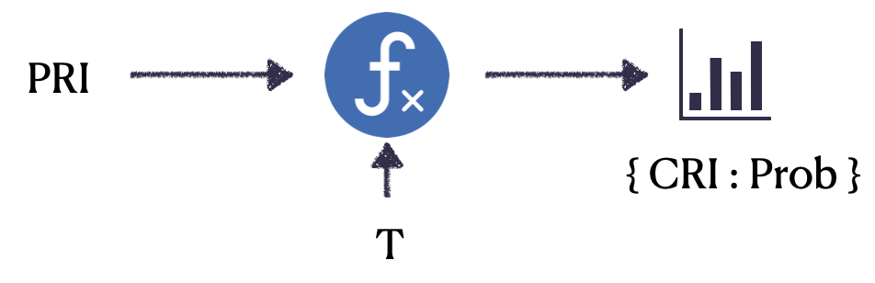
Big Picture
This figure came from Dr.Fangzhou Liu’s Thesis Presentation

Slide 4
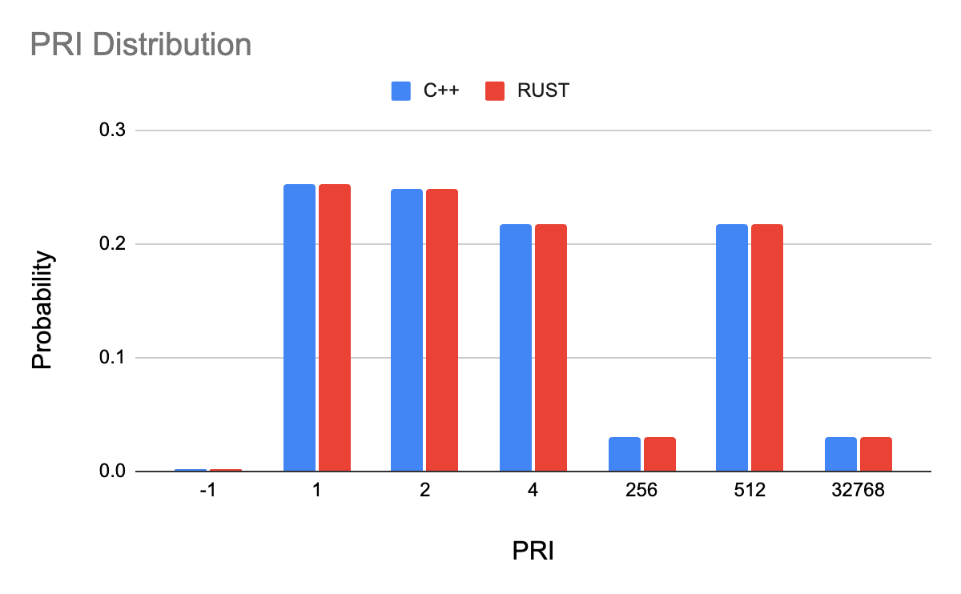
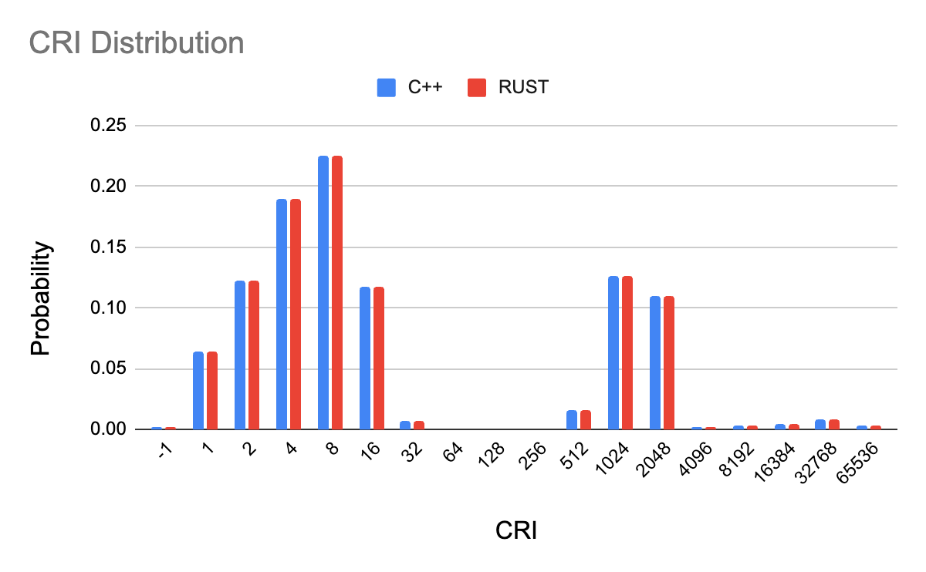
Accuracy Results

Slide 5
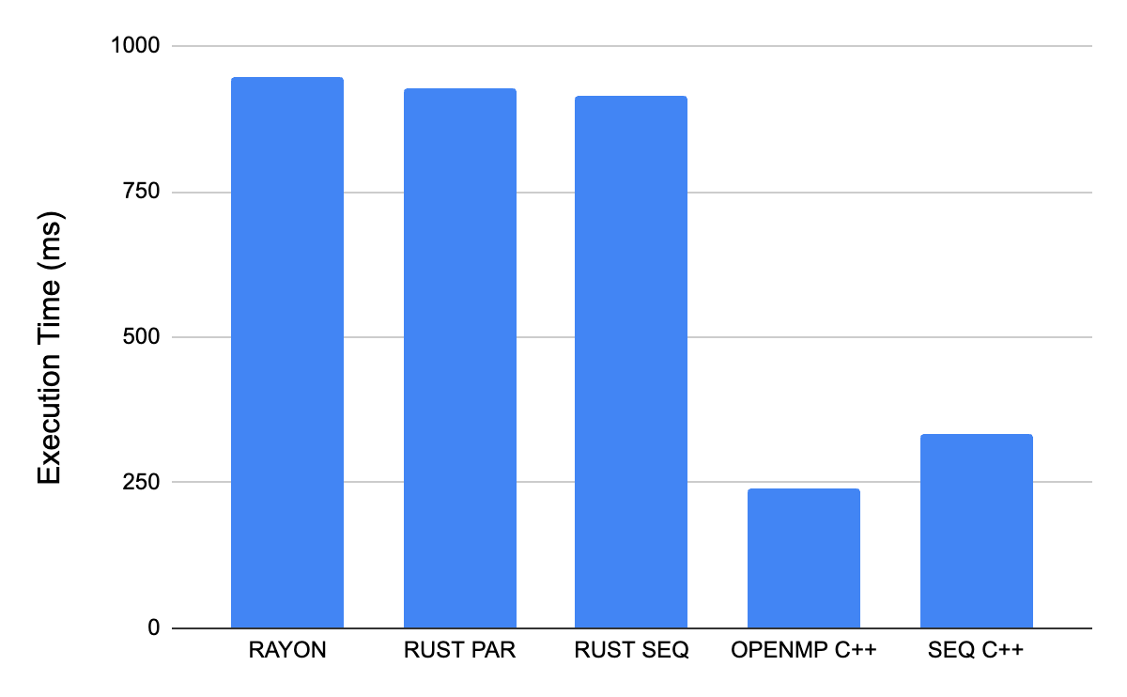
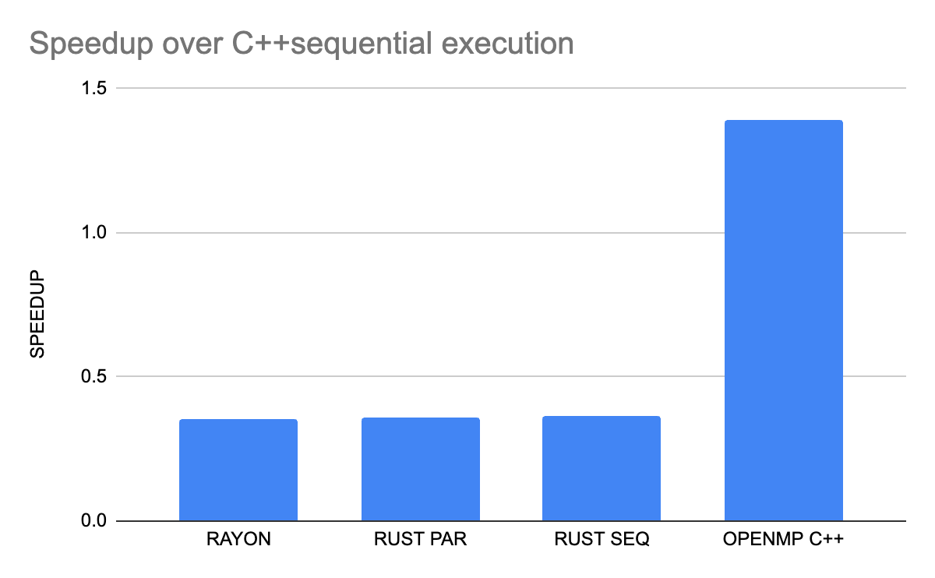
Performance Results
All results are tested on this MacBook Pro with 8 core M1 Pro chip.
Notes:
Can not test them on Cycle machines due to hyper-threading issues. Will run into results like c++ para is lower than c++ seq etc.

Slide 6
Our Rust vs CPP
Mutex: Safe but overhead
Handle edge cases
Cover uninitialized cases
lazy_static! {
pub static ref _NoSharePRI: Arc<Mutex<[Histogram; THREAD_NUM]>> = Default::default();
static ref _RIHist: Mutex<Histogram> = Mutex::new(Histogram::new());
static ref _MRC: Mutex<HashMap<u64, f64>> = Mutex::new(HashMap::new());
static ref _SharePRI: Arc<Mutex<[HashMap<i64, Histogram>; THREAD_NUM]>> = Default::default();
}

Slide 7
Our Rust vs CPP
Mutex: Safe but overhead
Handle edge cases
Cover uninitialized cases
if self.chunk_size != 0 {
self.avail_chunk = if self.trip % self.chunk_size == 0 {
self.trip / self.chunk_size
} else {
self.trip / self.chunk_size + 1
};
}

Slide 8
Our Rust vs CPP
let (cid, tid, pos) = if is_in_parallel_region {
let cid = ((ivs[parallel_iter_idx] - start) / step) / (CHUNK_SIZE * THREAD_NUM);
let tid = ((ivs[parallel_iter_idx] - start) / step) / CHUNK_SIZE - cid * THREAD_NUM;
let pos = ((ivs[parallel_iter_idx] - start) / step) % CHUNK_SIZE;
(cid, tid, pos)
} else {
(0, 0, 0)
};
Mutex: Safe but overhead
Handle edge cases
Cover uninitialized cases

Slide 9
Our Rust Parallel Implementation
Rayon
(0..THREAD_NUM).into_par_iter().for_each(...)
count.lock().unwrap().par_iter().sum();
std::thread
thread::spawn(...)

Slide 10
Acknowledgement
Dr. Fangzhou Liu
Prof. Chen Ding

Slide 11
Q&A

